Slide 1
Etiology and Treatment of Eating Disorders
Dr. Amna Khawar
Assistant Professor
Department of Applied Psychology
LCWU

Slide 2
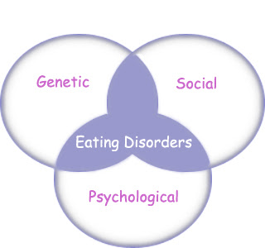
Etiology

Slide 3
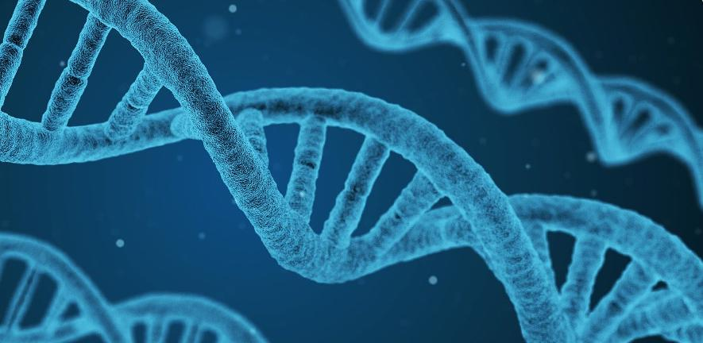
Genetic Factors
According to research there is a certain genes that may leave certain individuals susceptible to eating disorders.
Relatives of people with eating disorders are up to six times more likely than other individuals to develop the disorder themselves.

Slide 4
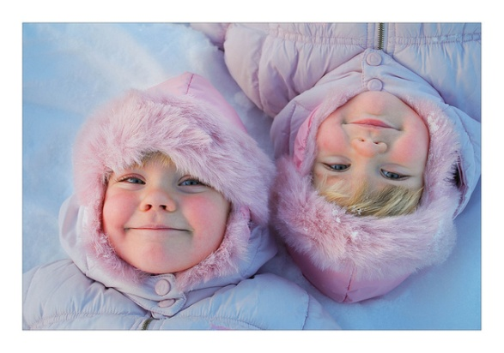
Twin Studies
Anorexia Nervosa
If one identical twin has anorexia nervosa, the other also develops 70% of the time.
In fraternal twins there is 20% chance of developing anorexia nervosa.
Bulimia Nervosa
In bulimia nervosa, identical twins
display a concordance rate of 23%
In fraternal twins the rate of developing bulimia is 9%

Slide 5
Neurobiological Factors
Role of Serotonin
Research has found a link between eating disorders and the genes responsible for the production of serotonin.
Some suggest low serotonin activity is related to eating disorders.
Some suspect abnormal serotonin activity-a condition to which certain individuals may be predisposed-causes the bodies to crave and binge.

Slide 6
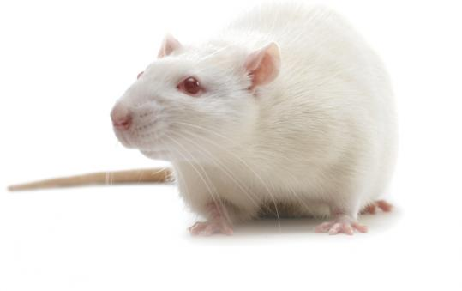
Role of Hypothalamus
Lateral Hypothalamus (LH) produces hunger when it is activated.
Rats experiment
Ventromedial Hypothalamus (VMH) reduces hunger when it is activated.
Rats experiment

Slide 7
Weight set point
Hypothalamus, related brain areas and other chemicals working together comprise a “weight thermostat” which is responsible for keeping an individual at a particular weight level called the weight set point.
Role of LH &VMH

Slide 8
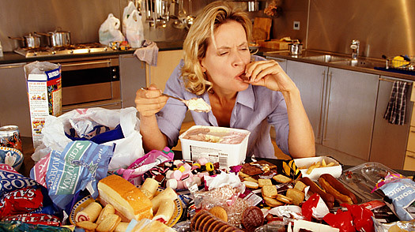
Psychological Factors
Psychodynamic Factors
Cognitive Factors

Slide 9
Psychodynamic Factors: Ego deficiencies
Hilde Bruch developed a psychodynamic theory for eating disorders.
Disturbed mother-child interactions lead to serious ego deficiencies (poor sense of independence and control) and severe perceptual disturbances that jointly help produce the disorder.
Parents may respond to their children either effectively or ineffectively
Effective parents attend to their children’s biological and emotional needs.
Ineffective patents fail to attend to their children’s need accurately.

Slide 10
How eating disorder develops
Step 1
Ineffective parenting
Step 2
Children may grow up confused unaware of their own needs and emotions
Step 3
To overcome their sense of helplessness they seek excessive control over their body size and shape and over their eating habits.
Feeding at times of anxiety and comfort at times of hunger
Not knowing when they are hungry or full
They fail to develop self reliance and experience not being in control of their own behaviour, need and impulses, as not owning their own bodies
they can not rely on internal signals they turn to external guide such as parents

Slide 11
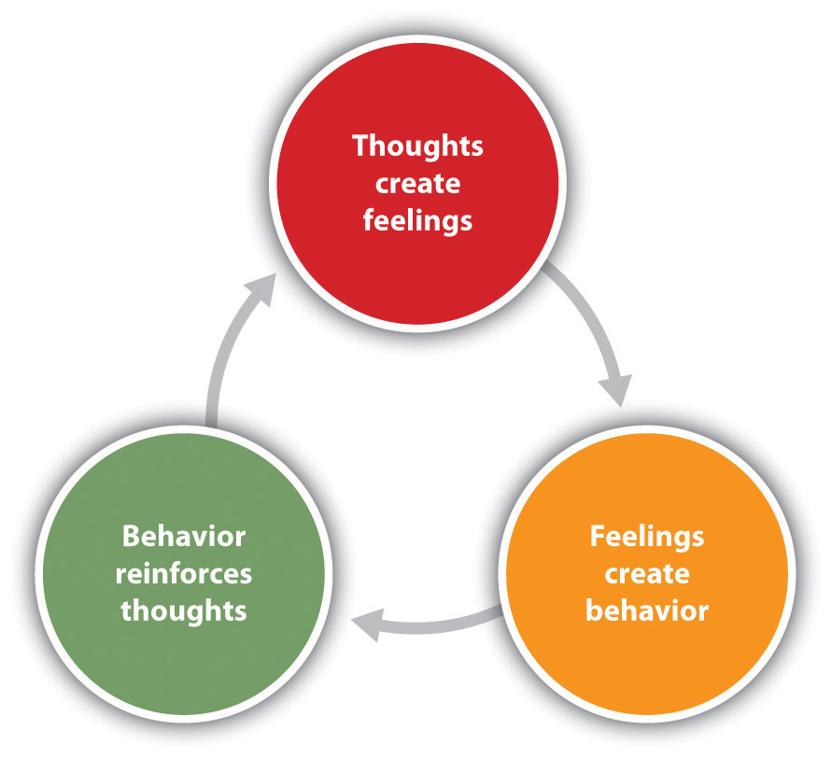
Cognitive behavioural Factors

Slide 12
Cognitive Behavioural Factors for AN
Fear of fatness motivating factors
Body image disturbance (positive reinforcement)
reinforce weight loss
Reduction of anxiety about becoming fat negative reinforcement
behaviour is maintained

Slide 13
Schematic of cognitive behavioural theory of BN
Low self esteem
Dieting to feel better about self
Diet is broken
Binge
Compensatory behaviour

Slide 14
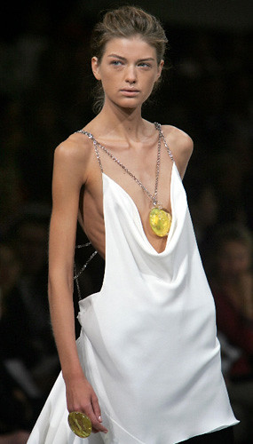
Sociocultural Factors
Societal pressure (models, mannequins and Barbie dolls)
Family environment
Child abuse
Gender influence

Slide 15
Treatment
1. How are proper weight and normal eating restored?
Intravenous feeding
Rewards
Supportive nursing care
Gradually increase patient’s diet
2. How are lasting changes achieved?
Anti depressents
Cognitive behaviour therapy
Changing family interactions
Interpersonal therapy

